Slide 1

KKGiSL INSTITUTE OF TECHNOLOGY
COIMBATORE
DEPARTMENT OF computer science & engineering
FINAL YEAR Project phase review # final
Iot Based Smart Parking System
Team members:
711719104056 Neethiarasan S
711719104060 Nithesh V
711719104079 Sanjay K
711719104106 Veerakumaravelu M
Under the guidance of :
Ms.Aruna TN, AP/CSE

Slide 2

agenda
Objective of the project work
Existing System
Proposed System
Expected Outcome
References
Timeline

Slide 3
ABSTRACT
The Smart Parking System with Integrated Payment and Slot Monitoring is an innovative solution that leverages IoT technology to provide a seamless and efficient parking experience. It enables users to easily find available parking slots, make payments securely, and receive instant notifications.

Slide 4
EXISTING SYSTEM
Traditional parking systems rely on manual ticketing, cash-based payments, and limited information about parking availability. Drivers may experience difficulties in finding parking spots during peak hours.
DRAWBACKS OF EXISTING SYSTEM
Inconvenient payment methods
Manual monitoring and enforcement
Inefficient space utilization
Lack of user convenience
Difficulties in integration with modern technologies

Slide 5
Literature Survey
SNo | Published Year | Paper Title | Authors | Technology
1 | 2022 | A novel method for quantification of vacant parking spaces at on-street parking lots | Kieu-Ha Phung; Quang Nguyen Huy; Nguyen Le; Dat Tran | Communication Networks
2 | 2021 | Real time analysis of Intelligent placing system for vehicles using IOT | Sushma Jaiswal; Dilip Kumar Sharma; Tarun Jaiswal; Bhimraj Basumatary; Mohit Tiwari; Tripti Tiwari | IoT and Deep Learning
3 | 2020 | IoT Based Smart Parking System Using Deep Long Short Memory Network | Ghulam Ali; Tariq Ali; Muhammad Irfan; Umar Draz; Muhammad Sohail; Wahyu Caesarendra; Maciej Sułowicz | IoT and Deep Learnig
4 | 2019 | A Practical Evaluation of a Secure and Energy-Efficient Smart Parking System Using the MQTT Protocol | Ali Alqazzaz; Raed Alharthi; Ibrahim Alrashdi; Esam Aloufi; Mohamed A. Zohdy; Hua Min | Elliptic Curve Cryptography
5 | 2018 | IoT-Enabled Parking Space Sharing and Allocation Mechanisms | Xiang T. R. Kong; Su Xiu Xu; Meng Cheng; George Q. Huang | IoT

Slide 6
Literature Survey
SNo | Published Year | Paper Title | Authors | Technology
6 | 2022 | RFID Smart Parking System Using IOT | Joel Charles; Aniket Dhage; Gayatri Bodele; Trupti Bargat; Dr. Jyotsna Gawai | RFID
7 | 2021 | Mobile Application Based Parking System Control and Monitoring Model with Motor Vehicle Parking | Budi Tjahjono; Nizirwan Anwar; Nixon Erzed; Rudi Heri Marwan; Euis Heriyati | Data Analytics and Cloud Computing
8 | 2020 | IoT based Smart Parking System using NODE MCU ESP8266 | Shivam Kanojiya; Sameer Wakade; Himanshu Gachake; Roshni Nair; Prof. Nazish Fatima | Sensors
9 | 2020 | SMART CAR PARKING USING WI-FI AND BLYNK APP | Mr. Hulmani Apphgaon Abhishek; Mr. Khilari V. S.asha; Mr. Korac | Communication Networks
10 | 2019 | Automated car parking system | D. Azshwanth; D. Azshwanth; Mithul Titten Koshy | Motion Sensors

Slide 7
PROPOSED SYSTEM
The proposed IoT Smart Parking System utilizes real-time slot monitoring , automated payment processing, user-friendly interfaces, and enhanced parking management. Drivers can easily locate and reserve available parking spaces through mobile apps. Payments are made securely through electronic methods, eliminating the need for cash transactions.
ADVANTAGES OF PROPOSED SYSTEM
Improved parking experience
Efficient space utilization
Seamless payment process
Reduced traffic congestion

Slide 8
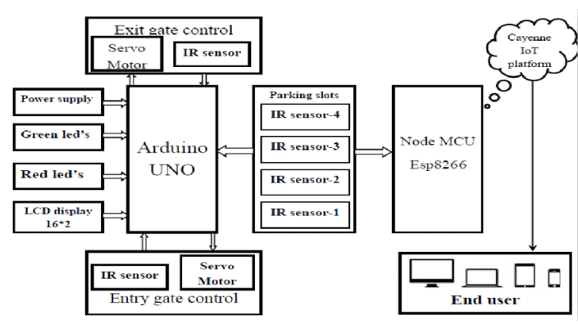
ARCHITECTURAL DIAGRAM

Slide 9
MODULES SPLIT UP
Module 1 : Sensor Module, IoT sensors detect occupancy status an transmit data to central system.
Module 2 : Communication Module, Reliable and timely data exchange between IoT components.
Module 3 : Central System Module provides real-time slot monitoring, reservation management, payment transactions, and reports.
Module 4 : User Interface Module allow users to interact with Smart Parking System.

Slide 10
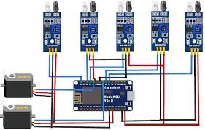
Module 1 : Sensor Module
IR SENSORS

Slide 11

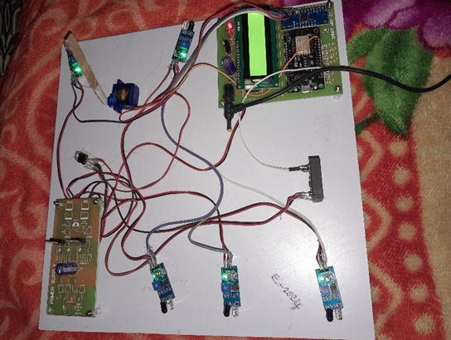
Module 2 : Communication Module
Connected through NodeMCU

Slide 12
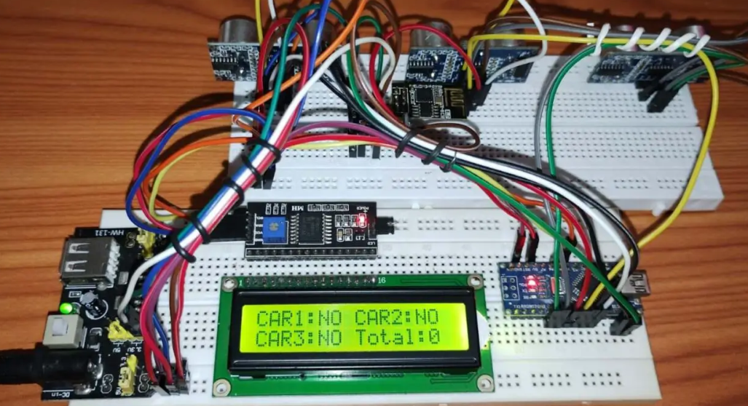
Module 3 : Central System Module

Slide 13
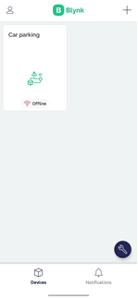
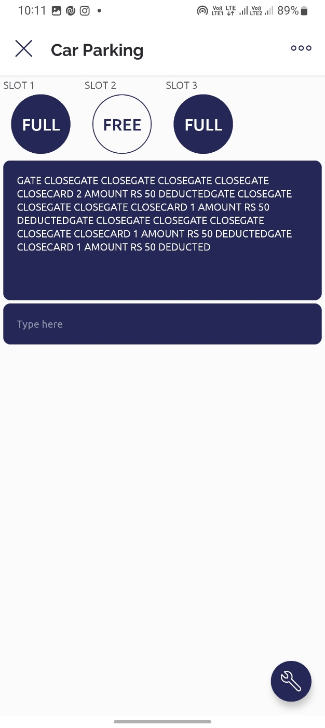
Module 4 : User Interface Module
LOG IN PAGE
SLOT MONITORING
PAYMENT VERIFICATION

Slide 14
REFERENCE
A. H. Daud et al., "An IoT-Based Smart Parking System for Efficient Parking Management,"
K. M. Pathan and S. H. Khan, "An Efficient Smart Parking System using IoT and Blockchain Technology," Smart Internet of Things (SmartIoT).
A. M. S. Alam et al., "An IoT-based Smart Parking System with Automated Slot Allocation and Payment,"
S. K. Mishra and S. L. Soni, "Design and Implementation of IoT-based Smart Parking System,"
R. K. Bal and S. N. Singh, "IoT-based Smart Parking System using Raspberry Pi,"

Slide 15
conclusion
IoT-based smart parking systems have the potential to significantly enhance parking management and improve the overall urban mobility experience. By leveraging real-time data, connectivity, and advanced analytics, these systems offer benefits such as reduced traffic congestion, enhanced convenience for drivers, and better resource allocation. With continued advancements in technology and increased adoption, IoT-based smart parking can contribute to more sustainable, efficient, and connected cities.

Slide 16
REFERENCE
M. S. Dhaliwal and S. K. Singh, "Smart Parking System with Online Reservation and Payment using IoT
N. Das et al., "Smart Parking System using IoT and Deep Learning Techniques,"
Bhagwatkar. A and S. Deshmukh, "Smart Parking System using IoT and Cloud Computing," in 2022
Andreev,S Borras, J Calveras A A Review on IoT for Smart Parking Application Sensors
Chatterjee,S Misra, S Munjal, R An IoT Enabled Intelligent Parking System for Smart Cities Future Internet.

Slide 17
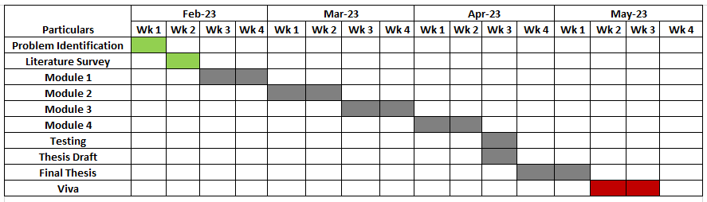
TIMELINE

Slide 18
THANK YOU

